Slide 1
Group Project
Reported by 09020119 陈闵恒
Group：09020115 张星喆
09020119 陈闵恒

Slide 2
1
Task introduction
CONTENTS
2
Method
3
code demo＆conclusion

Slide 3
Task introduction
PR0 :Fur-seal face recognition, Specifically, you are required to develop a model
Face Detection detects all the faces from a image that containing fur-seals
Face Recognition determines which faces are from the same fur-seal on an unlabeled dataset

Slide 4
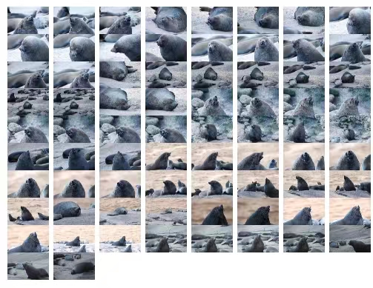
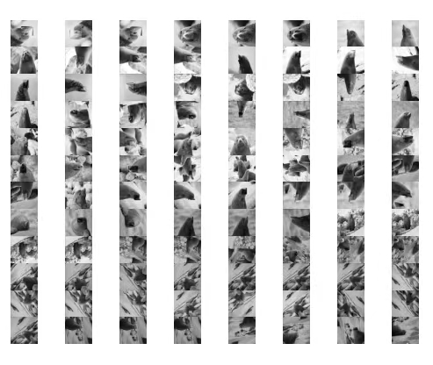
Task introduction
The dataset of our task are provided by our unite chair which contains 74 fur-seal images(5472X3648). A labelled data set available at Github and its format is completely consistent with the public MS COCO dataset. There are 96 images in the dataset, which have be divided into three folders. All the images have been highly augmented in advance.

Slide 5
Task introduction
The designed model can help answer the following questions:
• How many individual fur-seals in a given set of photos?
• Which fur-seals are often seen on the same beach at the same time (using image meta data)? or for simplification, appear on the same images.
• What is the potential relationship between those co-occurred fur-seals?

Slide 6
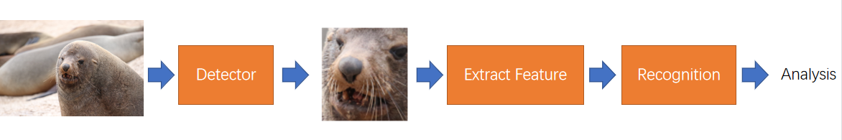
Method
Face Detection
Face Recognition

Slide 7
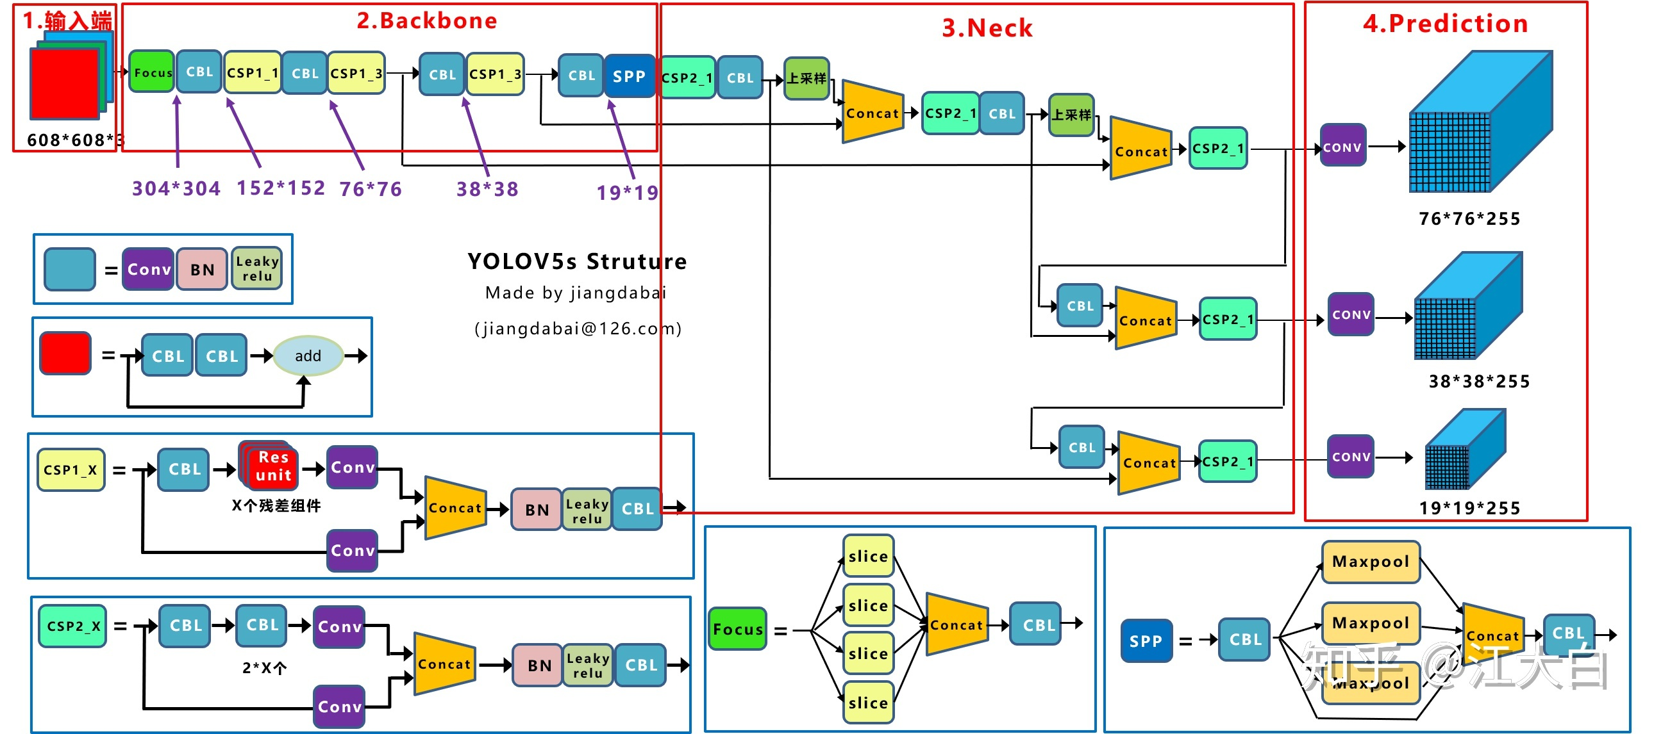
Face Detection
YOLOv5
One-shot learning: only a few examples in target domain

Slide 8
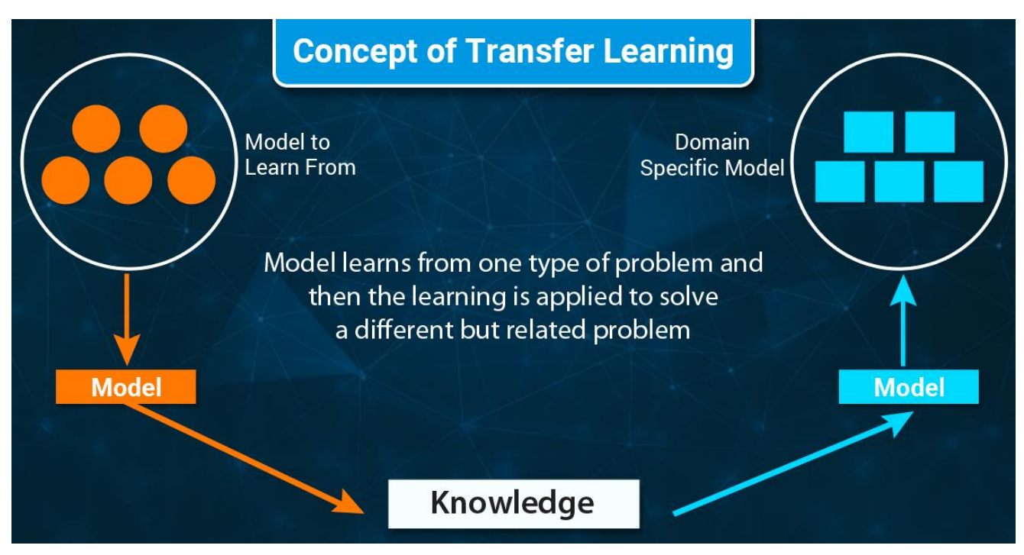
Face Detection

Slide 9
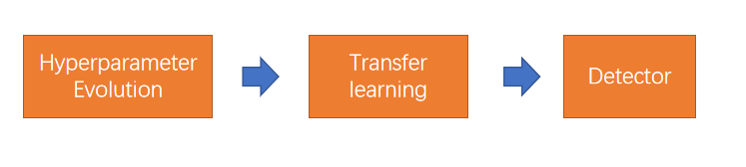
Face Detection
Hyperparameters in ML control various aspects of training, and finding optimal values for them can be a challenge.
Hyperparameter evolution is a method of Hyperparameter Optimization using a Genetic Algorithm (GA) for optimization.

Slide 10
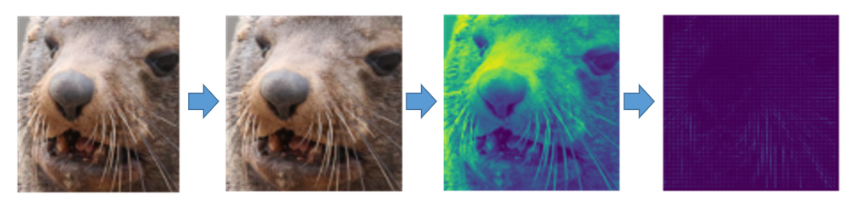
Face Recognition
HOG feature has been proved efficient in human detection.
The process of extracting HOG features in our method can be divided into three steps.
resize image to the size same as the input image of the detection network
convert it from RGB image to grayscale image
extract its HOG features from this grayscale image.

Slide 11
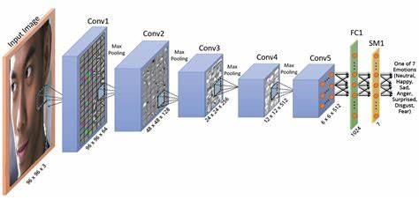
Face Recognition
Feature extracted by CNN
A pre-trained neural network can extract the feature maps it needs

Slide 12
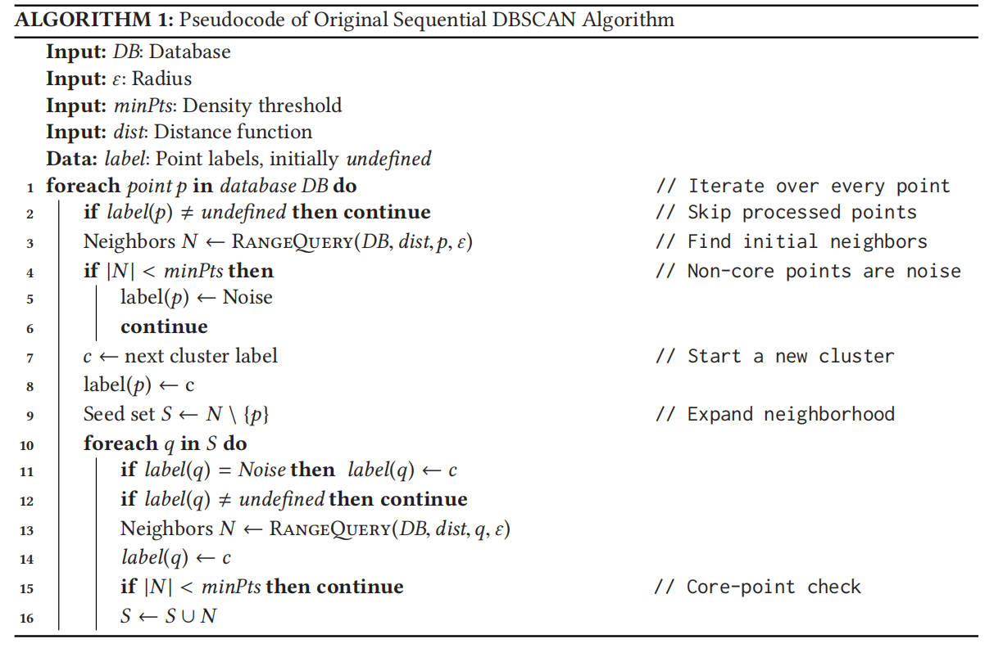
Face Recognition
DBSCAN:is a density-based spatial clustering algorithm. We believe that this unsupervised density-based algorithm is suitable in feature clustering stage of our model.

Slide 13
Code Demo
Talk is cheap, show me the code!

Slide 14
Conclusion
Detectors have room for improvement
Better Feature Extraction Methods

Slide 15
Thanks！
Thanks！
Thanks！

